Slide 1
Management frame, Control frames, Data frames

Slide 2
Contents
Management Frames
Control Frames
Data Frames

Slide 3
Management frames
Management frames allow wireless devices to form a network and manage the connections.
12 management frames
  Beacon frame- 1000
  Probe request frame- 0100
  Probe response frame-0101
  Authentication frame- 1011
  Association request frame- 0000
  Association response frame- 0001
  Reassociation request- 0010
  Reassociation response- 001
  Disassociation-1010
  Deauthentication-1100
  ATIM- 1001
  Action- 1101

Slide 4
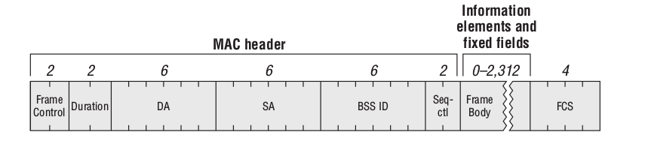
Management frame format

Slide 5
Beacon Frame
Beacon frames are used by access points to communicate throughout the serviced area the characteristics of the connection offered to the cell members.
Beacon frames are sent periodically, at a time called target beacon transmission time(TBTT).
The beacon time interval is 100TU

Slide 6
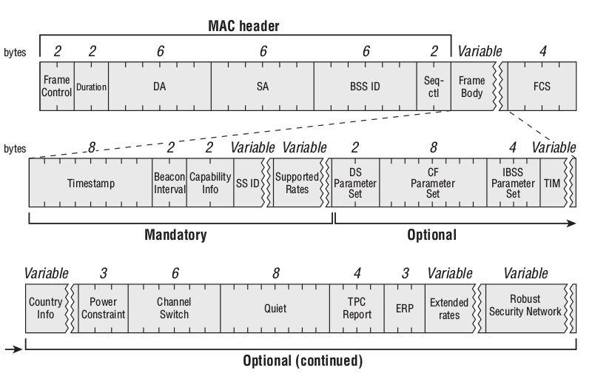
Beacon frame format

Slide 7
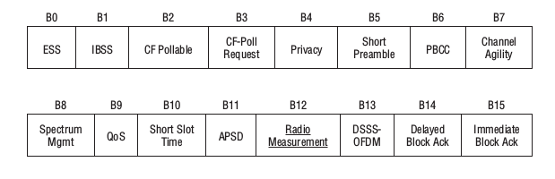
Capability information field

Slide 8
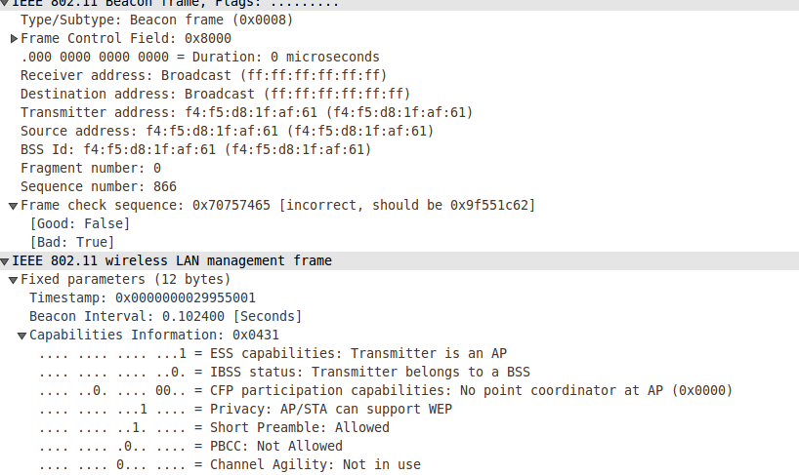
Beacon frame capture

Slide 9
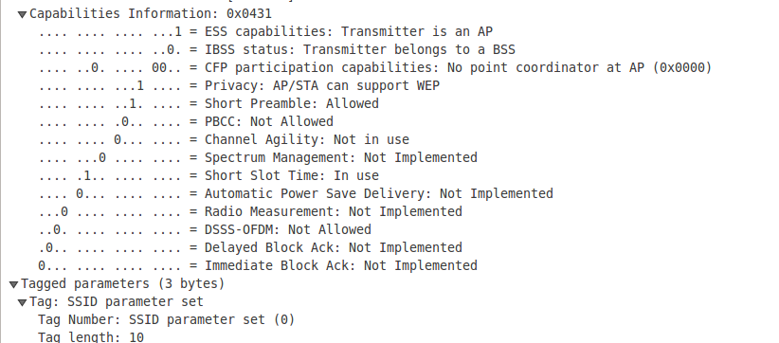

Slide 10
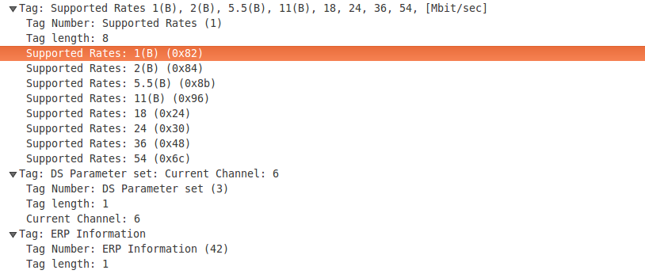

Slide 11
Probe Request frame
Probe request is management frame which aimed at asking what network is available on this channel.
The probe requests are usually sent to the broadcast DA address(ff:ff:ff:ff:ff:ff)
Once the probe is sent, the emitting starts a ProbeTimer countdown and waits for answers.
This Probe time is decided by vendor, but it is usually a lot shorter than a beacon interval.
At the end of the timer, the station processes the answers it has received.
If no answer was received,the station moves to the next channel and repeats the discovery process.
The purpose of a probe request is typically to discover APS and their supported networks.

Slide 12
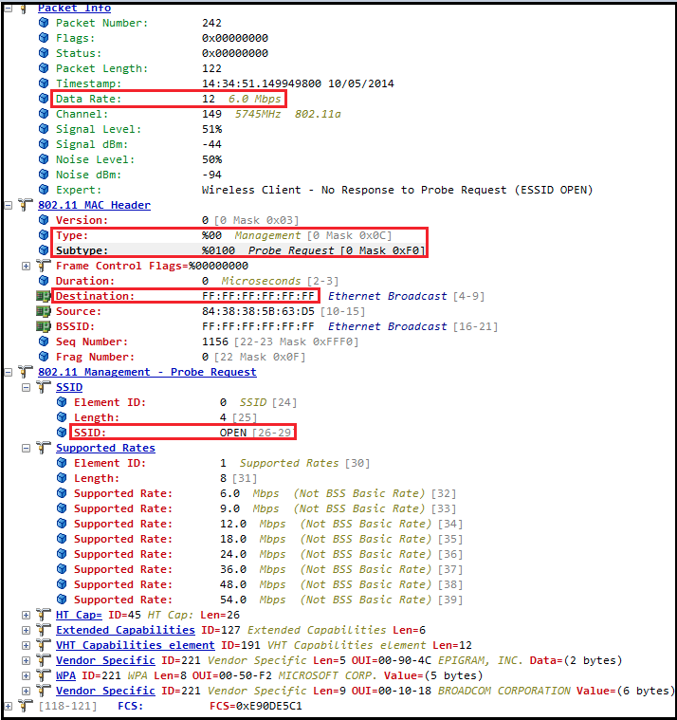

Slide 13
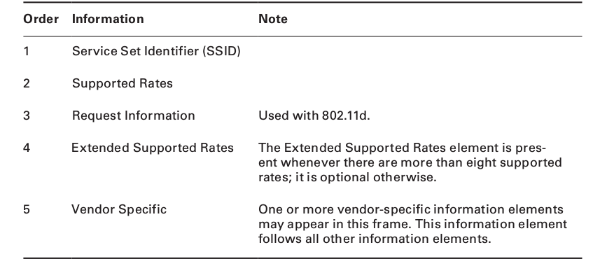

Slide 14
Probe response
Upon receiving a probe request frame, a station in an IBSS or an AP will respond with a probe response frame.
The probe response is sent as a unicast frame.
The probe response is sent at the lowest common rate supported by both the station sending the probe request and the answering AP
The probe response should be acknowledged by the receiving station,just like any other unicast frame.

Slide 15
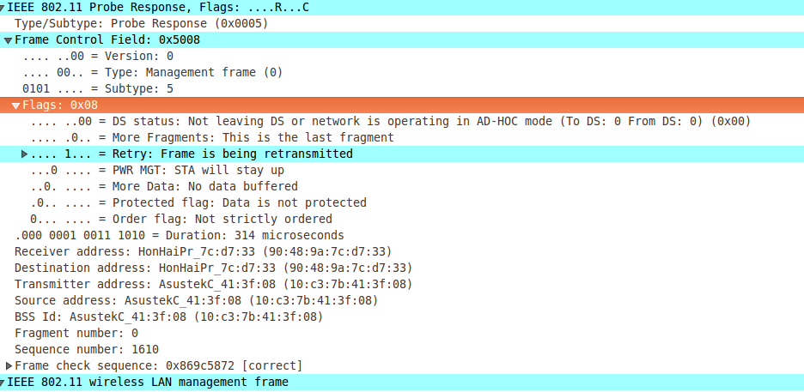

Slide 16
Authentication frame
The station sends the authentication frame to the AP to validate the device type means verify that the requesting station has proper 802.11 capabilities or not.
Two types of authentication
  Open system
  Shared key exchange

Slide 17
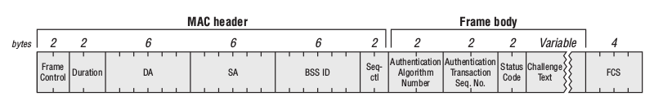
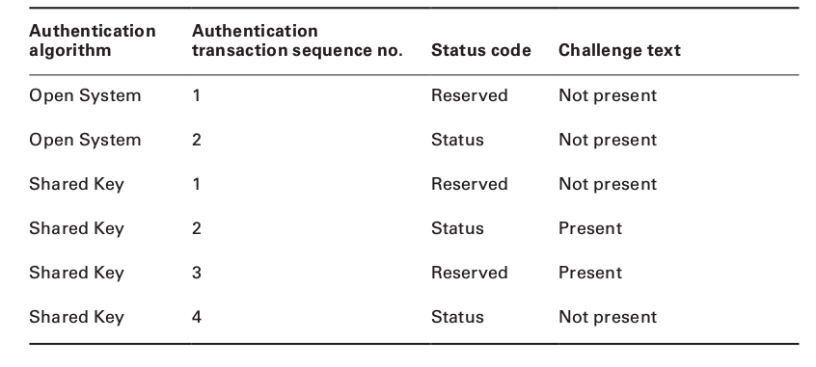

Slide 18
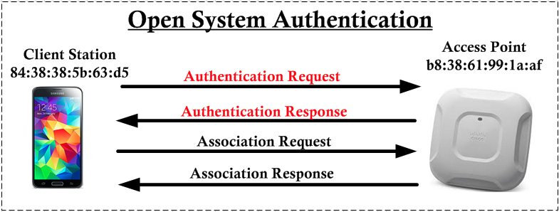
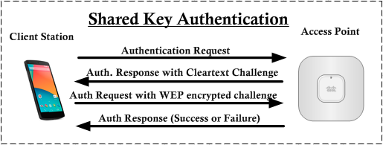

Slide 19
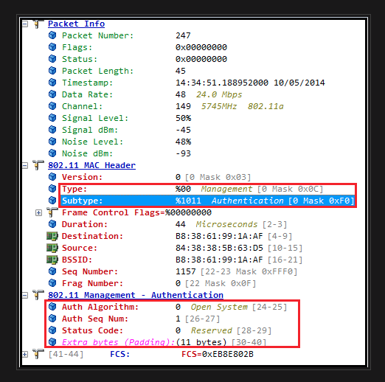

Slide 20
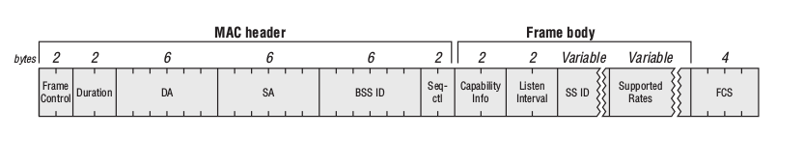
Association request frame
The Association frame is sent by the station to the Ap.
The purpose of this exchange is for the station to join the cell and obtaina cell member identifier called an association ID

Slide 21
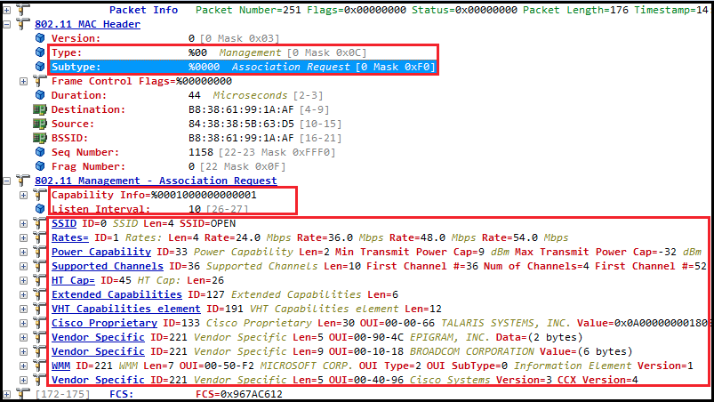

Slide 22
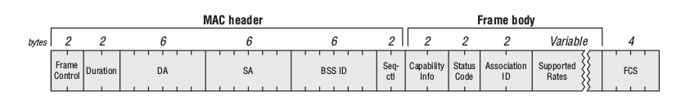
Association Response frame
After acknowledging the request frame, the AP examines each field of the request and verifies whether they all matches its own 802.11 parameters.
Once the station receives its association ID, it is associated to the cell and can start to communicate, sending data or moving to a second layer of authentication.
If the association fails, the station receives in the status code the reason for the failure.

Slide 23
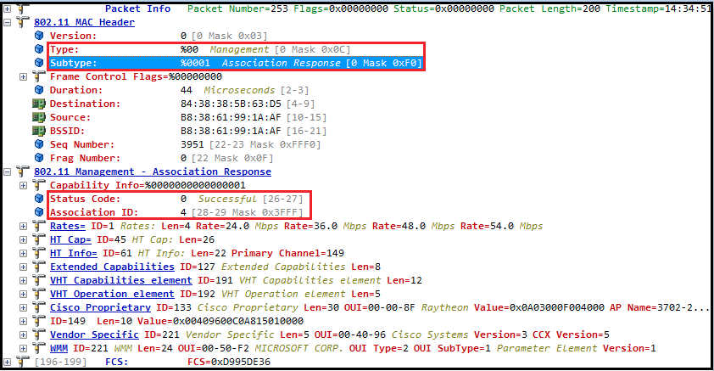

Slide 24
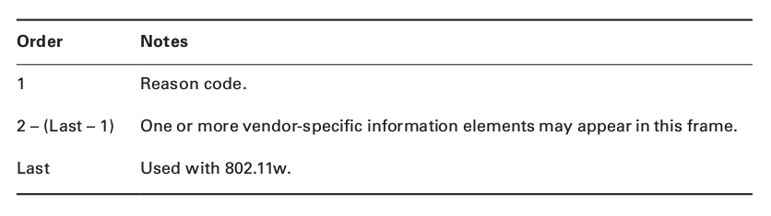
Deauthentication frame
The station or AP can also send a deaunthentication frame.
This frame is used when all communications are terminated

Slide 25
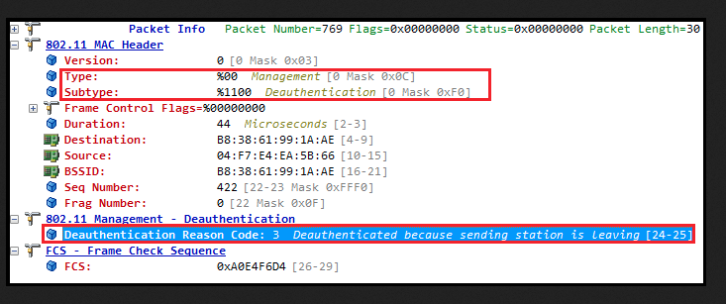

Slide 26
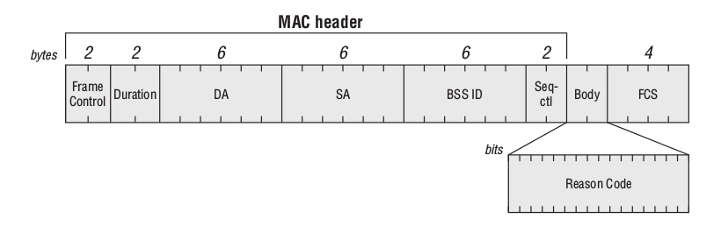
Disassociation Frame
Once a station is associated to an AP, either side can terminate the association at any time by sending a diassociation frame.
The disassociation frame may be the unicast or a broadcast

Slide 27
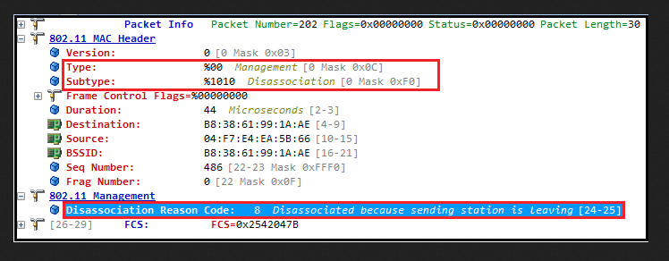

Slide 28
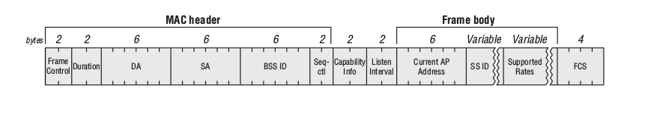
Reassociation Request Frame
Reassociation request frame can be sent only by a station to an access point.
The reassociation request frame is unicast and acknowledged frame.

Slide 29
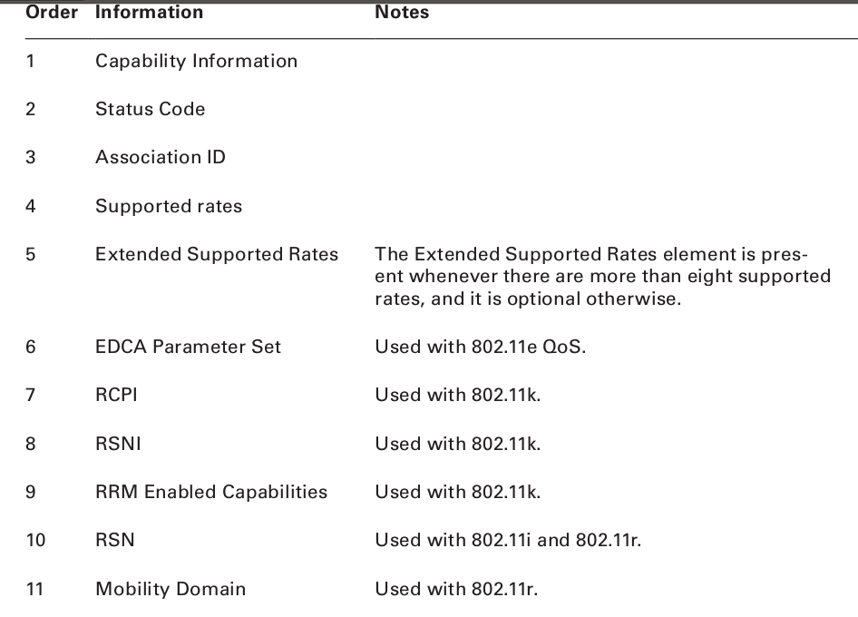
Reassociation response frame
An AP uses the reassociation response frame in response to reassociation request frame.

Slide 30
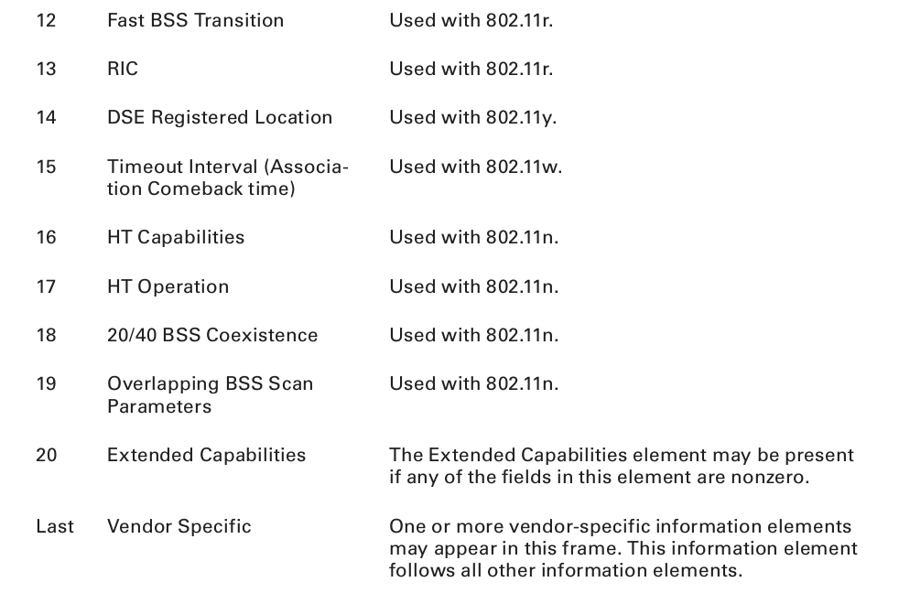

Slide 31
ATIM Frame
The ATIM frame is specific to IBSS networks and used for distribution of buffered frames to stations in sleep mode in the ad hoc network.
Beacons in IBSS are sent by any participating stations.
There is an ATIM window in the beacon to indicate that participating stations should not fall back to doze mode.
During the ATIM window, the ATIM frame is used to distribute broadcast and multicast packets.

Slide 32
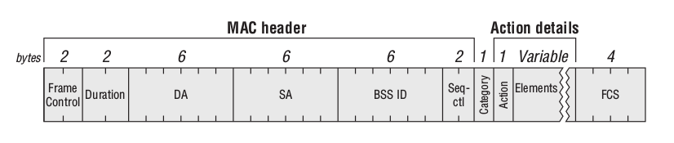
Action Frame
Action frames are used to trigger specific actions.

Slide 33
Action frames allow a form of added control to the cell, where the station can tell the AP, or AP can tell one or several stations, “i need you to do this or that” or “This is what is going to happen.”
Types of action frames:
  0-Spectrum management.
  1-Qos.
  2-DLS.
  3-Block Ack.
  4-Public.
  5-Radio measurement.
  6-Fast BSS transition.
  7-reserved
  8-SA query.
  9-Protected dual of public action.
  10-125 – reserved.
  126 - vendor-specific protected.
  127 – vendor specific.
  128-255 -Error.

Slide 34
Control frames
Control frames assist with the delivery of the data and management frames.
Control frames do not have frame body.
Control frames contain only a layer 2 header and trailer.
Transmitted at different data rates.

Slide 35
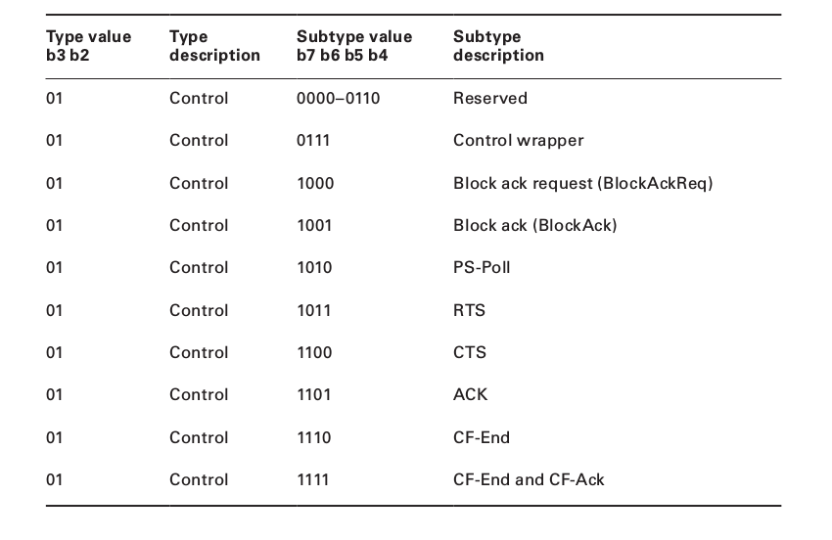

Slide 36
RTS/CTS Frames
Request to send(RTS) and Clear to Send(CTS) frames are used to enhance the virtual carrier sense process.
Request to send/clear to send is a mechanism that performs a NAV distribution and helps prevent collisions from occuring.
The NAV distribution reserves the medium prior to the transmission of the data frame.
When RTS/CTS is enabled on a station, every time the station wants to transmit a frame, it must perform an RTS/CTS is exchange prior to the normal data transmission.
When the transmitting station begins to transmit data, it first sends a 20 octet RTS control frame.
The duration value of the RTS frame includes the time needed for the subsequent frames in the transmit operation to be transmitted.

Slide 37
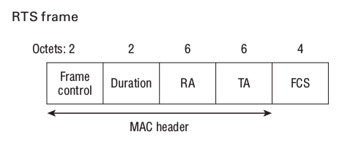
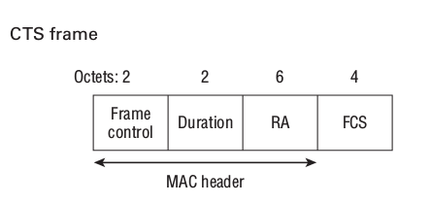
After the RTS frame transmitted, the receiving station respond by sending 14-octet CTS control frame.
The duration value of the frame includes the time needed for the subsequent frames in the transmit operation to be transmitted.

Slide 38
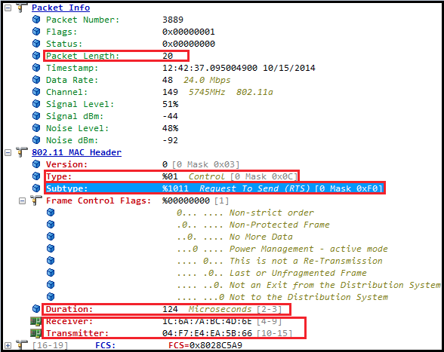

Slide 39
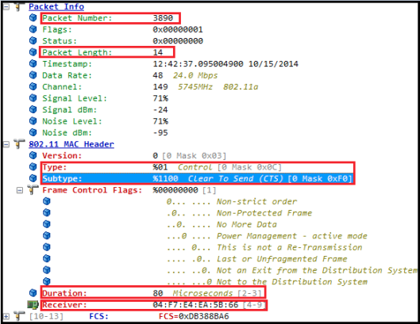

Slide 40
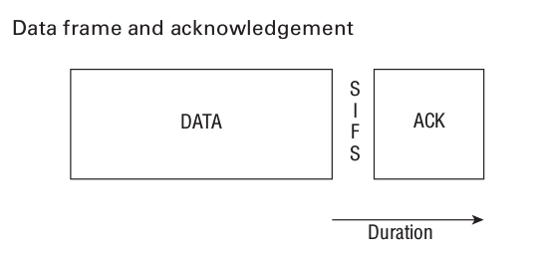
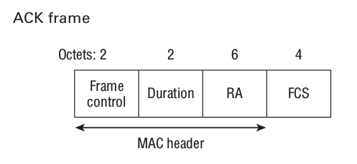
Acknowledgement Frame
Every time an 802.11 radio transmits a unicast frame, if the frame is received properly, the 802.11 radio that received the frame will reply with a 14 octet acknowledgement(ACK) frame

Slide 41
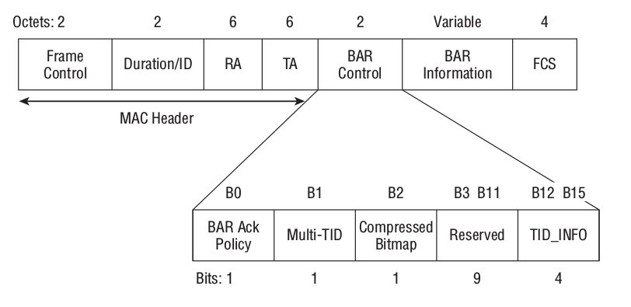
Block acknowledgement request

Slide 42
A block acknowledgement improves channel efficiency by aggregating several acknowledgement into one single acknowledgement frame.
When a station intends to use the Block ACK mechanism to transmit QoS data, it first checks to see whether the peer station is capable of performing the Block ACK mechanism.
Each of the frames has the Ack Policy subfield in the QoS Control field set to Block ACK.

Slide 43
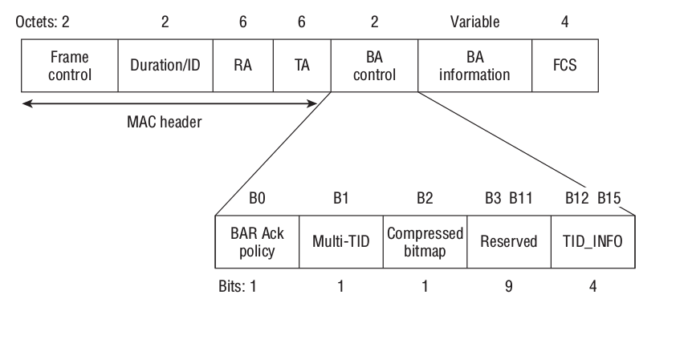
Block Acknowledgement
The Block Ack is used to acknowledge a block of QoS data frames, instead of acknowledging each unicast frame independently.

Slide 44
PS-Poll
When a client statio is set for Power Save mode, it will shut down some of the trasceiver components for a period of time to conserve power.
The station indicates that it is using Power save mode by changing the value of the Power Management bit set to 1, the access point is informed that the client station is using power management, and the access point buffers all of the client's 802.11 frames.
If the access point is buffering a data for a station in power save mode, when the access point transmits its next beacon, the AID of the station will be seen in a field of the beacon frame known as the traffic indication map(TIM).

Slide 45
The TIM field is a list of all stations that have undelivered data buffered on the access point waiting to be delivered.
Every beacon will include the AID of the station until the data is delivered.
After a sleep for longer period the station will be awaken and start to receive the beacon frames.
When station receives a beacon, it checks to see whether its AID is set in the TIM, indicating that a buffered unicast frame waits.
If so, the station will remain awake and send a 20-octect PS-Poll frame to the access point.
After receiving the PS-Poll frame the ap will send the buffered unicast frame to the station.

Slide 46
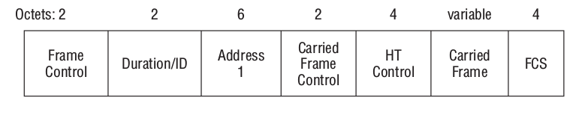
Control Wrapper
The Control Wrapper was defined by the 802.11n amendment, which defined high throughput(HT) transmissions.
The control Wrapper used to carry any other control frame together with an additional HT Control field.
The FCS files of the Control Wrapper frame is a typical FCS field containing a 32 bit CRC , calculated over all the fields of the MAC header and the frame body, in this case the Carried Frame field.

Slide 47
Contention free
Two addition control frames
  CF-End
  CF-End+CF-ACK
CF-End is a 20 octet frame that is used to indicate the end of a contention-free period
The CF-End+CF-ACK frame, is a 20-octect frame that is used to indicate the end of a contention free period and acknowledge receipt of a frame.
Both of these control frames defined for use with an optional medium access method known as Point Coordination function(PCF).

Slide 48
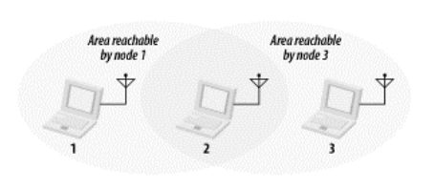
The Hidden Node problem

Slide 49
Data Frames
Data frames transport the information across the network in the wireless portion of the user network.
Each data frame is represented by a Type value of 10 and different group of 4 Subtype bits.

Slide 50
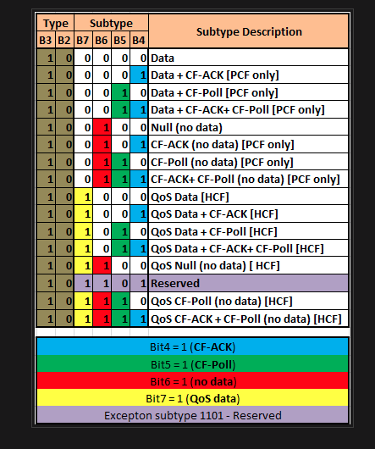

Slide 51
Subtypes
1. Null(no data):-Send by station
2. CF-Ack(no data):- Send by the station
3. CF- Poll(no data):- Send by the access point
4. CF-Ack+CF-Poll(no data):- Send by the Access point
5. Data :- Send by the station/Ap
6. Data+CF-Ack:- send by station
7. Data+CF-Poll:- Send by AP
8. Data+CF-Ack+CF-Poll:- send by AP
9. QoS data :- Send by the AP/station
10. QoS data+ CF-Ack :- Send by station
11. QoS Data+CF-Poll :- Send by AP
12. QoS Data+CF-Ack+CF-Poll :- Send by AP

Slide 52
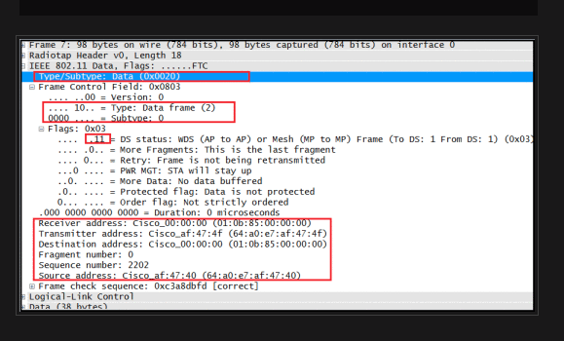
Simple data frames

Slide 53
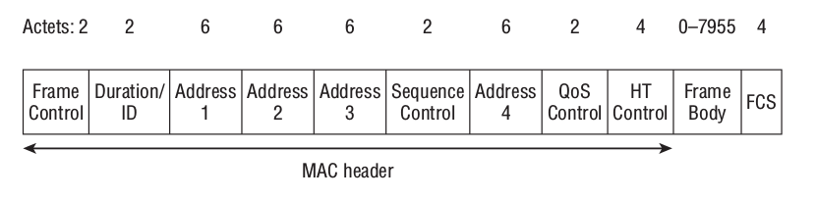
QoS and Non-Qos Data Frames

Slide 54
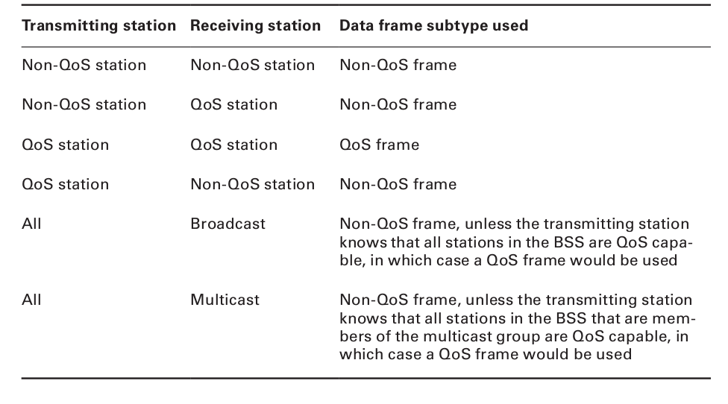

Slide 55
Thank you

